Slide 1


New Security Challenges for Persistent Memory
Naveed Ul Mustafa, Yuanchao Xu, Xipeng Shen, Yan Solihin
Notes:
I am Naveed Ul Mustafa from University of Central Florida, presenting our work “New Security Challenges for Persistent Memory”.
This work is performed in collaboration with NC state university.

Slide 2
Overview
PM abstractions
File systems
Persistent memory objects (PMOs)
Security threats from use of PM
Data remanence → encryption
Early wear out by repeated writes → wear leveling
Security threats from use of PMO model
Make unauthorized accesses to PMOs difficult
What are the threats and when protection is affective?
Notes:
Let me first provide overview.
There are different ways to view persistent memory.
For example, as a fast medium for hosting file systems.
Or as large persistent main memory holding persistent data structures encapsulated in objects.
Most of previous work on security of persistent memory explores threats from use of persistent memory.
For example, using encryption to address data remanence problem
Or mechanisms to handle early wear out due to repeated write attacks.
There are only couple of studies on security threats from use of PMO model.
They focus on making unauthorized accesses to PMO difficult.
But provide no detail on what are the threats and when protection is affective. Our work aims to fill this gap.

Slide 3
Outline
Background
PMOs
Security implications of PM
Previous work
PMO threat model
Attack types
Possible defenses
Conclusion
Notes:
In rest of presentation, I will first introduce PMO abstraction and security implications of persistent memory
Then discuss previous related work
Followed by PMO threat model assumed in this work.
Then I will present attack type
And possible defenses against them
Before concluding the presentation.

Slide 4
PMOs
Abstraction to hold pointer-rich regular data structures encapsulated in objects [1].
Managed by OS
No file system backing
attach()/detach() to map/unmap a PMO
Direct access by load/store
Notes:
PMO is a general system abstraction for holding pointer rich persistent regular data structures encapsulated in objects.
PMOs are managed by OS providing name-space and permission settings.
And they are not backed by a file system.
A process can map or un-map a PMO by invoking attach and detach system calls.
PMO resident data is then directly accessible to a process through load/store instructions.

Slide 5
Background: Security Implication of PM
vs DRAM data
“Memory protection practices for DRAM apply to PM” [2] but not sufficient.
PMO corruption is persistent and hence challenging.
PMO corruption is transmittable between runs.
Attackers can figure out the target locations incrementally.
vs Files
Pointer rich data structures.
Direct access to PMO data and pointers, no serialization involved.
Data accesses transparent to OS (load/store), no security check performed by OS.
Notes:
What are the security implication of PMO model and persistent memory?
First, its important to note that Memory protection practices for DRAM apply to persistent memory but are not sufficient.
Because, unlike DRAM, PMO corruption is persistent and hence challenging.
Furthermore, such corruption is transmittable between runs of application(s).
Since PMOs can be shared between processes, attackers can figure out the target location in a victim process incrementally.
When contrasted with files, PMOs contain pointer rich data structures making them attractive target for attacks.
On top of that, processes have direct access to PMO data and pointers without need to perform serialization.
Since data is accessed directly through load/store instructions in a way transparent to OS, no security checks are performed by OS at time of data access. All these factors highlight the need for stronger security protection for persistent memory.

Slide 6
Previous work
MERR [1]:
Reduce exposure window
Split the page table and embed it in PMO to accelerate attach
PMO space layout randomization (PSLR)
Hardware based domain virtualization [3]:
Restrict access to PMOs only to threads that access them.
Map PMOs into separate domains to leverage domain protection.
Philosophy:
Make unauthorized accesses to PMOs difficult
Shortcomings:
A vulnerable process with legit access can be used to attach a PMO and launch attack.
PMO sharing may break inter-process isolation guarantees.
What are the threats and when protection is affective?
Notes:
Lets have a look at previous work focusing on security challenges due to PMO model, their philosophy and shortcomings.
First such study, focuses on increasing security of PMOs by reducing their exposure time. Mainly, they propose attaching a PMO when needed for access and detaching afterward.
To accelerate the attach process, page table referring to a PMO is splited and embedded in PMO itself.
Also, PMO space layout randomization is performed to make it hard for an attacker discovering PMO pointers and data across multiple runs.
Another study focuses on restricting access to PMO only to threads that access them.
And for that purpose, PMOs are mapped into separate domains to leverage domain protection.
Both studies follow same philosophy of making unauthorize accesses to PMO difficult.
However, it is possible that an attacker uses a vulnerable process with legal access to attach a PMO and launch attack on an otherwise not vulnerable process. This results in cross-process and cross run security attacks.
Such attacks are possible because sharing of a PMO, at different times, between processes breaks inter-process isolation guarantees.
Also, previous works do no provide details of threats and when proposed protection is affective.

Slide 7
Threat Model
Multiple processes sharing a PMO at different times.
Victim: No known memory safety vulnerabilities.
Payload: Has memory safety vulnerabilities.
Adversary:
Use the payload to compromise the victim.
Knows that PMO is shared.
Knows data structures and layout of PMO.
PMOs: Contain buffers and pointers.
Trusted system software e.g., OS.
Manage address space isolation.
Applies permission checking.
Notes:
In our threat model We assume multiple processes sharing a PMO(s) at different times.
A victim process is assumed to have no known safety vulnerabilities.
While a payload process has such vulnerabilities.
An adversary uses the payload to compromise the victim through shared PMOs.
Adversary knows that PMO is shared, has knowledge of data structures and layout of PMO.
PMOs contain buffers and pointers.
We also assume trusted OS that manages address space isolation and applies permission checking when PMOs are attached by a process.

Slide 8
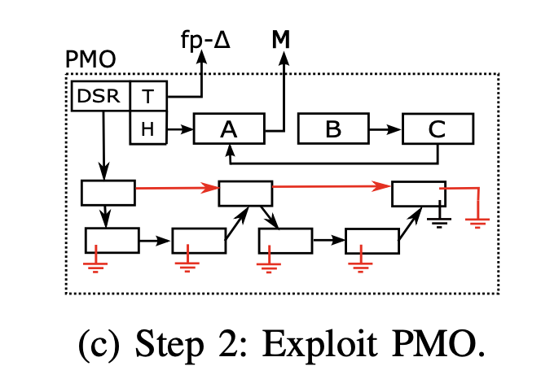
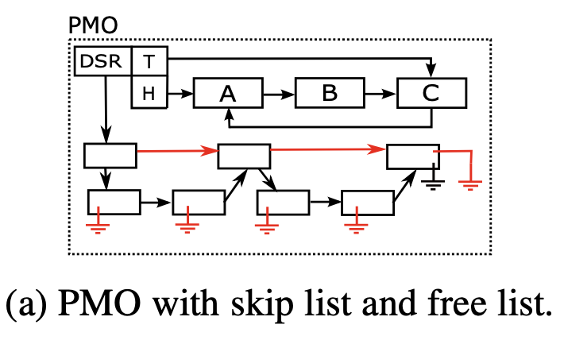
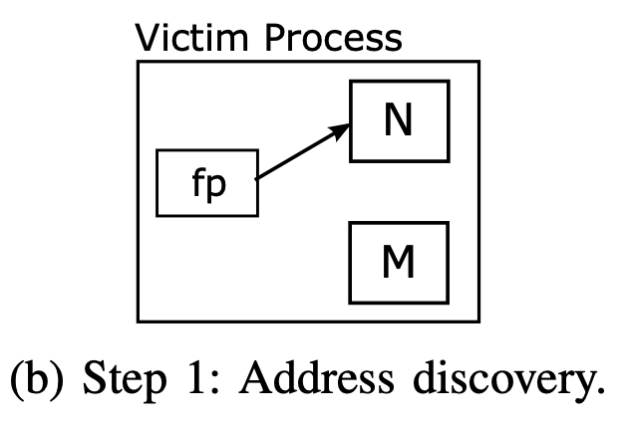
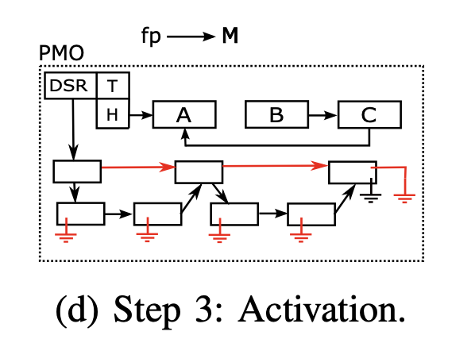
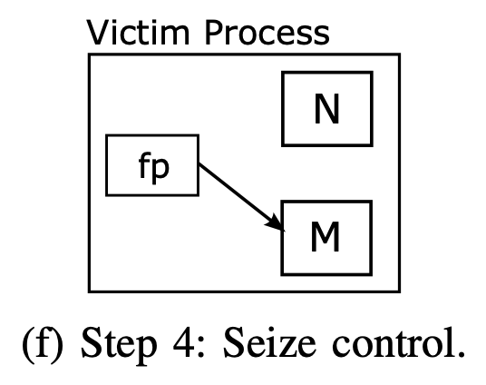
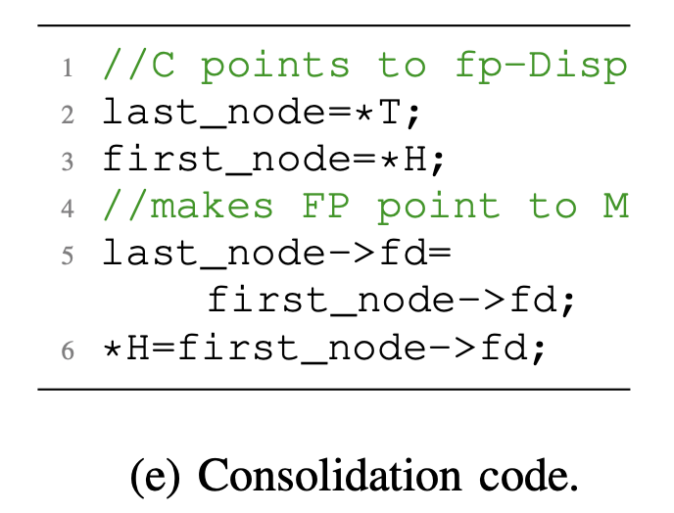
Cross-process/run control-data attacks
Notes:
Control-data attacks alter a program’s control data to execute injected or out-of-context code.
Consider a PMO consisting of skip-list and a circular list of free nodes, with separate head and tail pointers. Nodes are allocated from the head of free list.
In first step of attack, an attacker discover a function pointer fp and the target out-of-context code M in address space of victim process. Function pointer initially points to valid code block N.
In step 2, the adversary captures payload process, attach the PMO, and overwrite the forward pointer of first node such that it points to M. Also, the tail pointer is overwritten to point to fp – delta, where delta is constant displacement between address of a node and its fd pointer. After that PMO is persisted and detached.
when victim attaches PMO and node A is allocated, consolidation code is executed that removes the node A from free list and update the list.
The update causes fp pointing to M in step 3 of attack.
In step 4, when function pointer fp is used by victim, target code M is executed with attacker seizing control of victim.

Slide 9
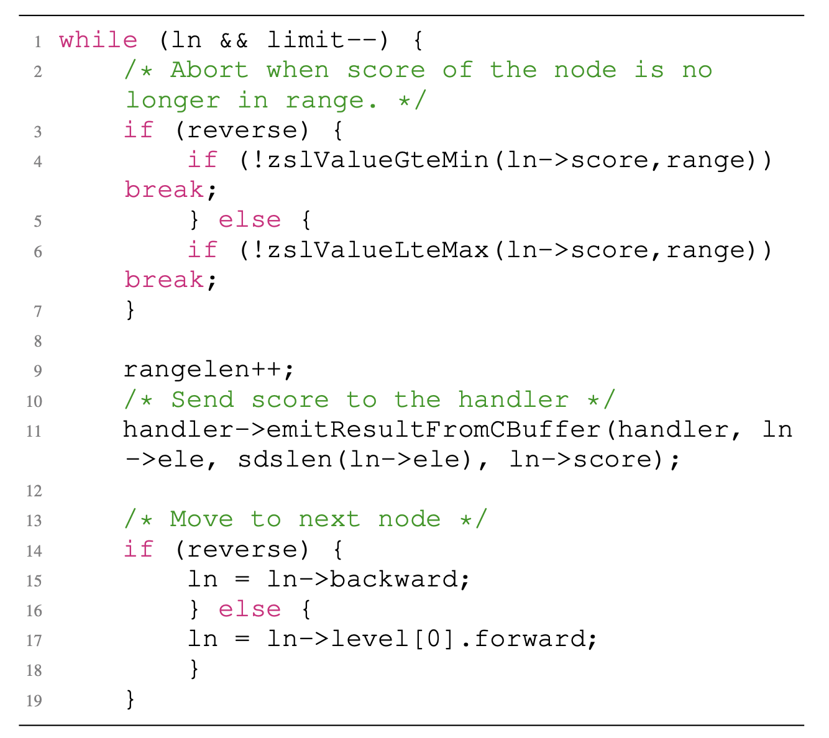
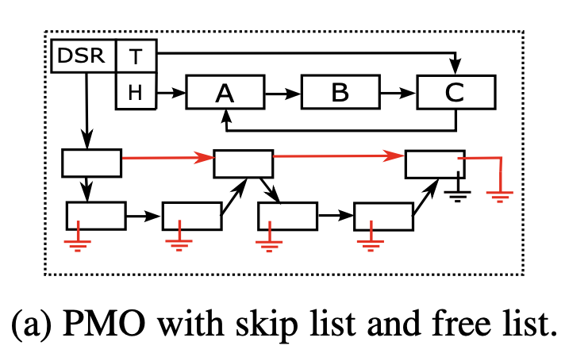
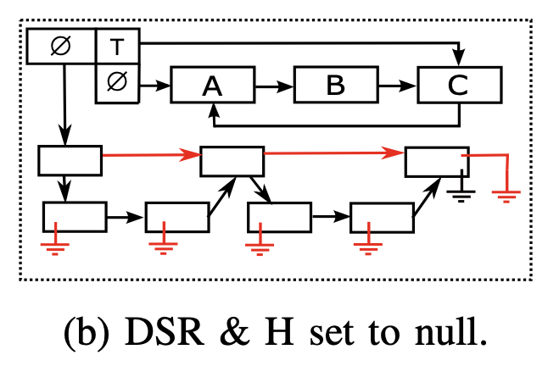
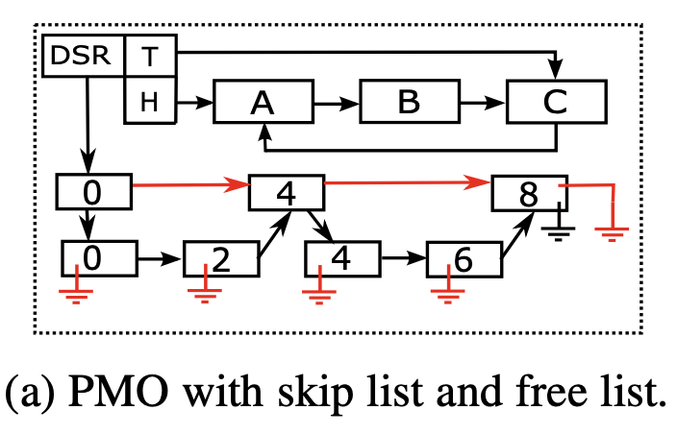
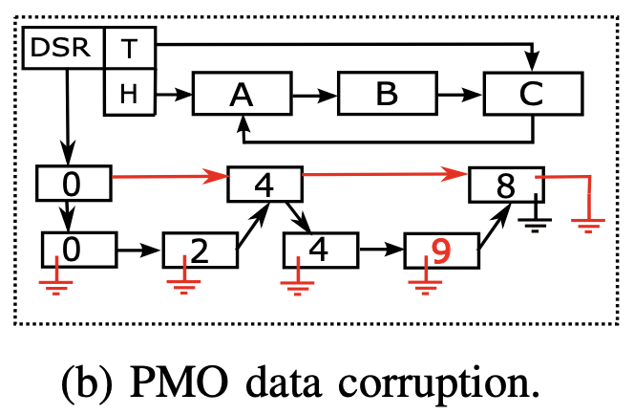
Cross-process/run non-control-data attacks
Denial of Service Attacks:
Attacks corrupting decision making data:
ZRANGE min max BYSCORE command
ZRANGE 4 8 BYSCORE
4 4 6 8
ZRANGE 4 8 BYSCORE
4 4
Notes:
Unlike control-data attacks, non-control data attacks depend on specific semantics of an application and corrupt variety of application data.
As an example, denial of service attack can cause an application to crash and can be launched through a PMO.
For example, consider an un-corrupted PMO.
An adversary can use payload process to attach a PMO, set DSR and head pointer to null, persist the PMO and detach it. When victim process attaches the PMO, it crashes as result of segmentation fault.
Cross process attacks corrupting decision data can also be launched through sharing of PMOs.
Consider the code snippet for ZRANGE command from REDIS that iterates over element of skip list and return elements in sorted order.
For example, invocation of ZRANGE 4 8 BYSCORE on un-corrupted PMO prints 4, 4, 6, 8.
However, when an adversary through a payload corrupts the PMO by overwriting node data from 6 to 9 and persists it,
a victim process sees different result on invocation of ZRANGE command.

Slide 10
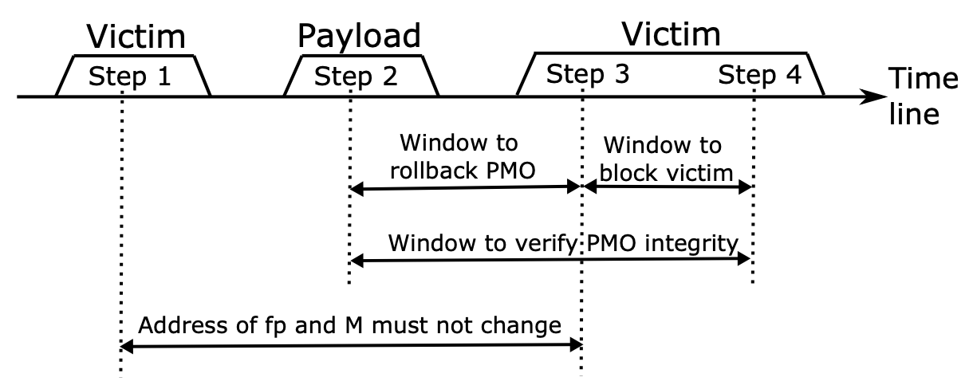
Possible Defenses
Some attacks can be mitigated using existing defenses (PSLR, DEP).
But some attack frameworks can breach PSLR or DEP.
Additional steps are needed to detect and foil attacks.
Steps 1) Address discovery (fp, M) 2) Exploit PMO 3) Activation 4) Seize control
Assumption: fp and M remain same between step 1 and 3 for attack to succeed.
Step 2 to Step 4: Time window to detect the attack.
Step 2 to Step 3: Time window to foil the attack
Step 3 to Step 4: Time window to foil the attack by terminating the victim process.
After Step 4: Too late
Notes:
Some attacks can be mitigated using existing defenses (PSLR, DEP).
But some attack frameworks can breach PSLR or DEP.
Additional steps are needed to detect and foil attacks. To understand the opportunities for improving security, lets revisit the cross-process attack of pointer redirection.
The figure shows steps of the attack.
Attack is successful if fp and M remain same between step 1 and 3.
Step 2 to Step 4: provides Time window to detect the attack.
Step 2 to Step 3 provides Time window to foil the attack (by restoring non-corrupted previous version of PMO).
From Step 3 to Step 4, attack can be foiled by terminating the victim process.
Its too late after step 4 to detect or foil the attack.

Slide 11
Possible Defenses
Denial of service attacks:
Don’t rely on pointers
Detect by performing data integrity check (e.g., SHA256 hash code)
Attacks corrupting decision making data:
Perform data invariance checks (test invariance properties of data)
Attack | Assumptions | Detection Strategy
Pointer redirection to out of context code | No PSLR or breached, PM2VM pointers | Topology verification
Pointer redirection to injected code | No PSL and DEP or both breached, PM2VM pointers | Topology verification
Denial of service |  | Hash re-computation and comparison
Corrupting decision-making data |  | Data invariance checking
Notes:
Denial of service attacks, Don’t rely on pointers.
They can be detected by performing data integrity check (e.g., SHA256 hash code)
Attacks corrupting decision making data can be detected by performing data invariance checks (i.e., test invariance properties of data)
In summary
Pointer redirection attacks can be detected by topology verification of PMO data structures.
Denial of service attacks can be detected by hash code comparison
While attacks corrupting decision-making data can bee detected by data invariance checking.

Slide 12
Conclusion
PMO sharing among processes makes PMOs a new tool for launching security attacks.
Demonstrated PMO-based attacks and possible defenses.
Increased memory safety (beyond DRAM security practices) is needed for PM.
Notes:
We showed, PMO sharing among processes makes PMOs a new tool for launching security attacks.
and Demonstrated those attacks with possible defenses.
We believe that Increased memory safety (beyond DRAM security practices) is needed for persistent memory.

Slide 13
Questions/Comments:

Slide 14
References
[1] X. Yuanchao, S. Yan, S. Xipeng, “MERR: Improving security of persistent memory objects via efficient memory exposure reduction and randomization,” In Proceedings of the Twenty-Fifth International Conference on Architectural Support for Programming Languages and Operating Systems 2020 Mar 9 (pp. 987-1000).
[2] (SNIA), S. N. I. A. Persistent memory hardware threat model. Technical Whitepaper (2018).
[3] X. Yuanchao, Y. ChenCheng, S. Yan, S. Xipeng, “Hardware-based domain virtualization for intra-process isolation of persistent memory objects,” In 2020 ACM/IEEE 47th Annual International Symposium on Computer Architecture (ISCA) 2020 May 30 (pp. 680-692). IEEE.

